Slide 1
Bank loan of customers ANALYSIS
Group – 5 ( Project Team Members )
1.Prashobh
2.Ziyadh Ahmad
3.Mohammed Wahaj
4.Gavish
5.Rayan Afthab

Slide 2
INDEX
KPI - 1 : Year wise loan amount Stats
KPI - 2 : Grade and Sub-Grade wise Revol_bal
KPI - 3 : Total payment for Verified Status vs Total payment for Non Verified Status
KPI - 4 : State wise and Last_credit_pull_d wise Loan Status
KPI – 5 : Home Ownership vs Last Payment date stats
Excel Dashboard
Tableau Dashboard
Power BI Dashboard
SQL .
Challenges Faced

Slide 3
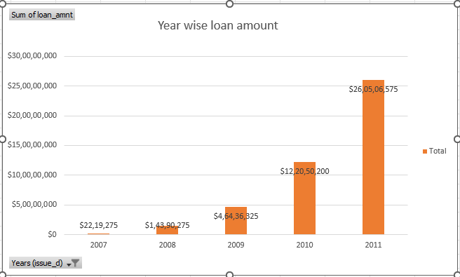
1st – KPI YEAR WISE LOAN AMOUNT STATS
By observing the chart we can see how Loan Amount is increasing by year.
Starts from 2007 the loan amount is 22,19,275 and in the 2011 the loan amount is 26,05,06,575. We can subtract the new value to the old value to see the difference
26,05,06,575 - 22,19,275 = 258287300
258287300 increased in the duration of 4 years
And Grand Total of all years is 44,56,02,650.00
Row Labels | Sum of loan_amnt
2007 | $22,19,275
2008 | $1,43,90,275
2009 | $4,64,36,325
2010 | $12,20,50,200
2011 | $26,05,06,575
Grand Total | $44,56,02,650

Slide 4
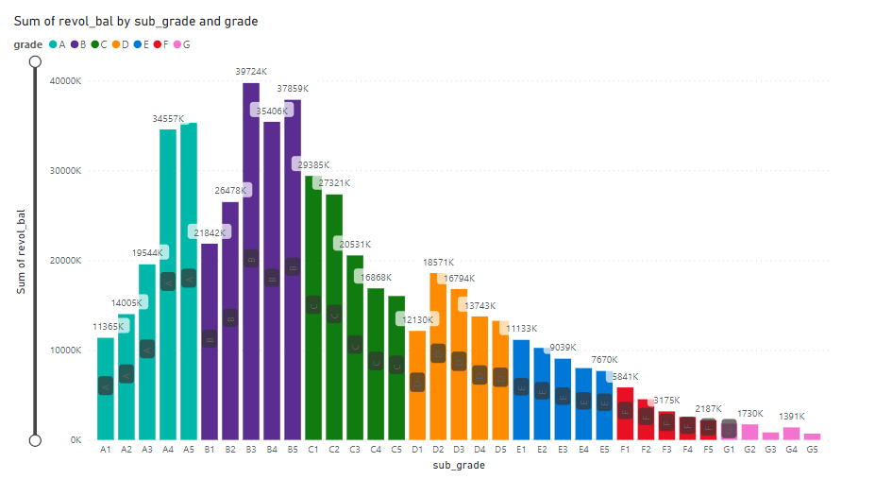
2nd – GRADE AND SUB-GRADE WISE REVOL_BAL
Based on analysis of the column of the chart from the image, it appears to illustrate the distribution of the sum of revolving balances across various sub-grades of loans. The chart highlights a few key performances
Understanding Borrower Behaviour: The distribution of revolving balances across different sub-grades and grades reveals patterns in borrowing behavior. For instance, the observation that mid-range sub-grades (B and C) have higher sums of revolving balances suggests that individuals in these categories might be more reliant on credit or have higher levels of debt. This can indicate a different risk profile compared to those in the highest (A) or lowest (G) grades.
Lending Strategy Development: By understanding the relationship between credit grades, sub-grades, and revolving balances, lenders can tailor their lending strategies. For example, they might offer different interest rates, loan amounts, or terms based on the borrower's grade and their level of revolving debt. This can help in managing risk while also providing competitive and customized loan products to borrowers.
Predictive Modeling: The relationship between revolving balances and credit grades can be incorporated into predictive models for loan performance. By analyzing historical data, lenders can identify patterns that predict default rates, allowing them to adjust their lending criteria and risk assessment models accordingly.

Slide 5
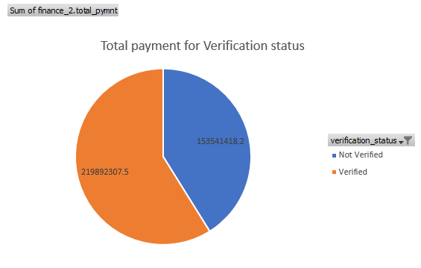
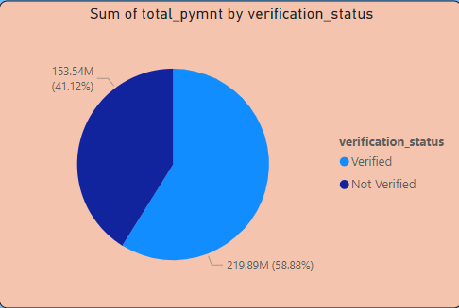
3rd – TOTAL PAYMENT FOR VERIFIED STATUS VS TOTAL PAYMENT FOR NON VERIFIED STATUS
This is the first stage of the verification process. The bank needs a loan application to initiate the document collection and verification process
Looking at pie chart we can observe that verified status have 58.88% of total payment and 41.12% of total payment which are Not Verified for the Loan Amount
This Ratio shows us how many people are non verified with there Total funded amount 14,03,38,873 similarly Verified with 19,57,99,725 total

Slide 6
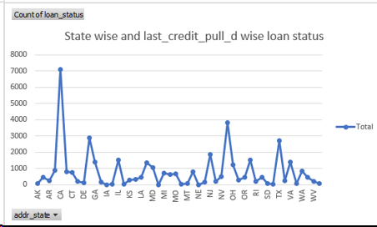
4th – STATE WISE AND LAST_CREDIT_PULL_D WISE LOAN STATUS
The image shows a line graph titled "State wise and last_credit_pull_d wise loan status." The graph is plotting the count of loan_status against different US states, which are represented on the x-axis (labeled as addr_state). The y-axis represents the count of loan_status, ranging from 0 to 8000.
The states are abbreviated with their standard two-letter postal codes, and they appear to be in alphabetical order, starting from AK (Alaska) and ending with WY (Wyoming). The line graph has peaks and troughs, indicating the variation in the count of loan statuses across different states.
Here are some notable observations from the graph:
The state with the highest count of loan_status is California (CA), with a peak that appears to be just over 7000.
Other states with relatively high counts include FL (Florida), GA (Georgia), IL (Illinois), NJ (New Jersey), NY (New York), and TX (Texas), all of which have peaks above 2000.
Many states have counts below 1000, with some of the lowest being states like ND (North Dakota), SD (South Dakota), VT (Vermont), and WY (Wyoming), which have counts close to the baseline of the graph.
The graph provides a visual representation of the distribution of loan statuses across different states, which could be useful for identifying regional trends in lending or borrowing behavior. However, without additional context or data, it's difficult to draw specific conclusions or understand the underlying factors driving these patterns.

Slide 7
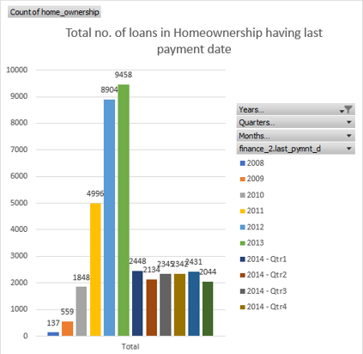
5th – HOMEOWNERSHIP VS LAST PAYMENT DATE STATS
The image displays a column chart titled "Total no. of loans in Homeownership having last payment date." The chart shows the count of home ownership loans on the y-axis, ranging from 0 to 10,000, and the x-axis represents different time periods, specifically years and quarters within 2014.
The years included in the chart are 2008, 2009, 2010, 2011, 2012, 2013, and the quarters of 2014 (Qtr1, Qtr2, Qtr3, Qtr4). Each year or quarter is represented by a different color.
Here are the observed values for each year or quarter:
2008: 137 loans
2009: 559 loans
2010: 1848 loans
2011: 4996 loans
2012: 8904 loans
2013: 9458 loans
2014 - Qtr1: 2143 loans
2014 - Qtr2: 2343 loans
2014 - Qtr3: 2434 loans
2014 - Qtr4: 2044 loans

Slide 8
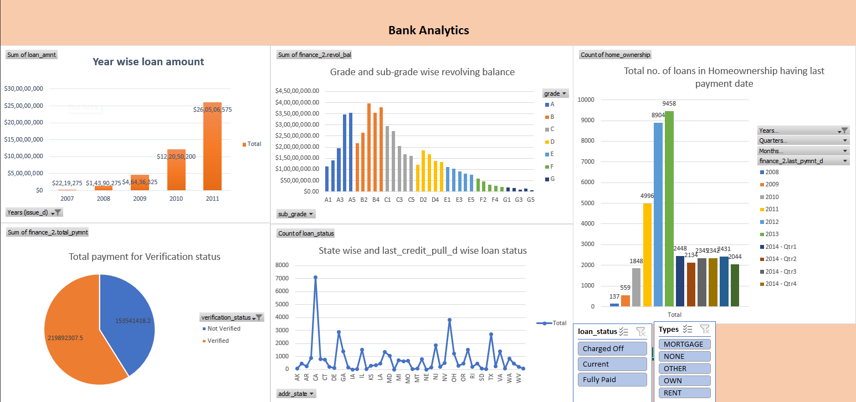
EXCEL DASHBOARD

Slide 9
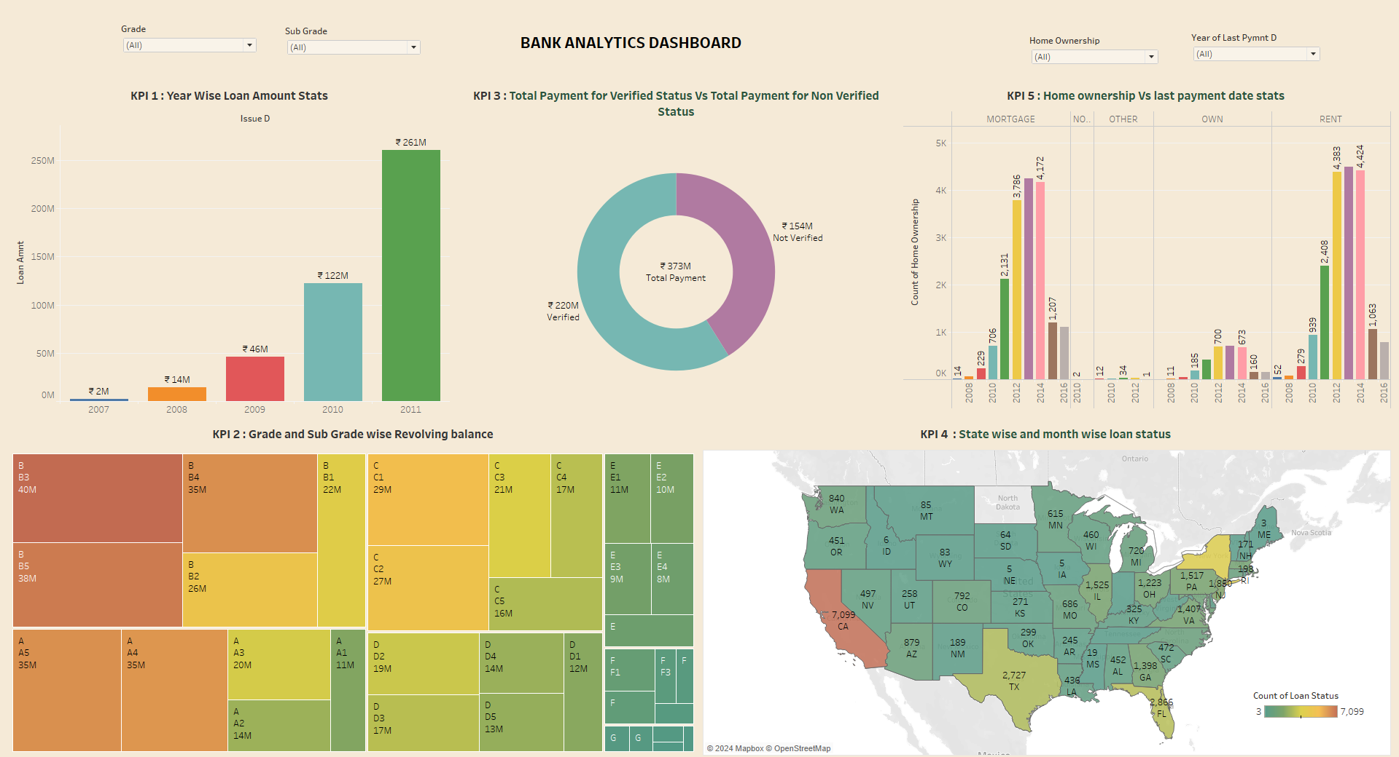
TABLEAU DASHBOARD

Slide 10
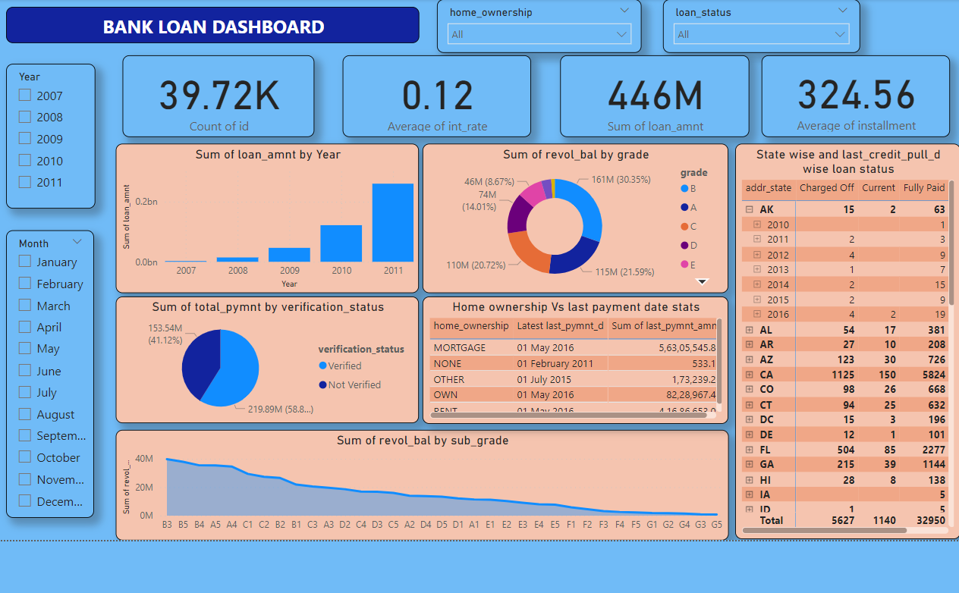
POWER BI DASHBOARD

Slide 11
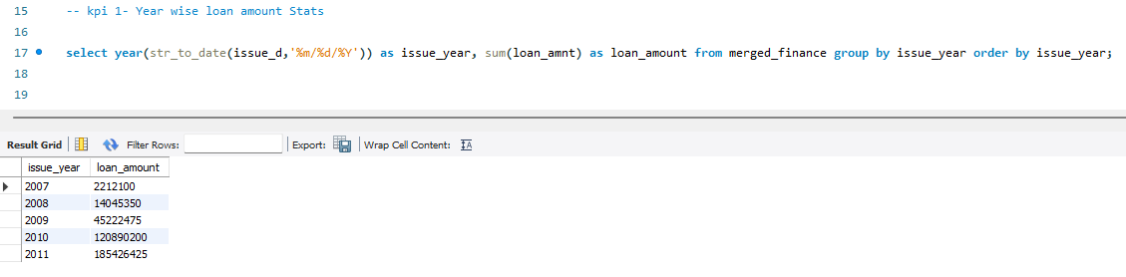
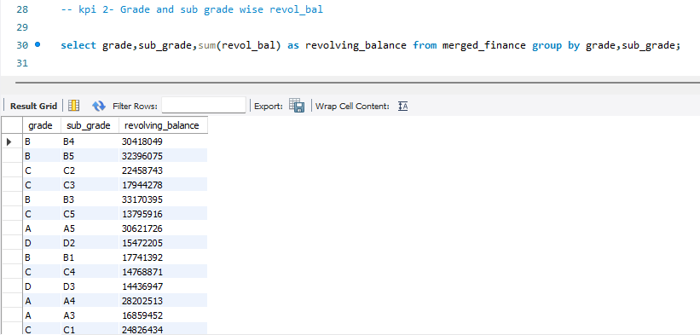
SQL
KPI - 1
KPI - 2

Slide 12
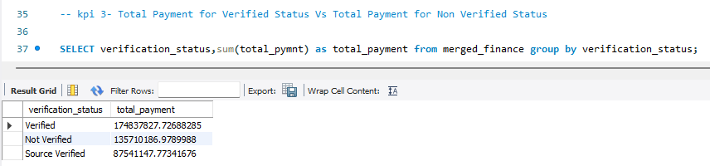
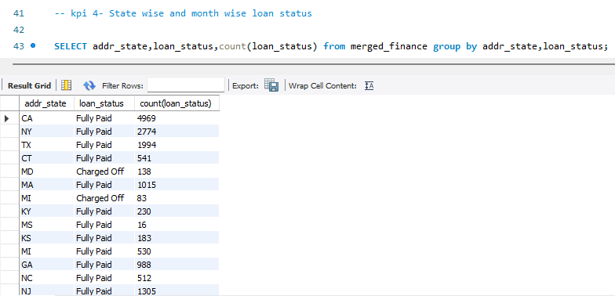
KPI - 3
KPI - 4

Slide 13
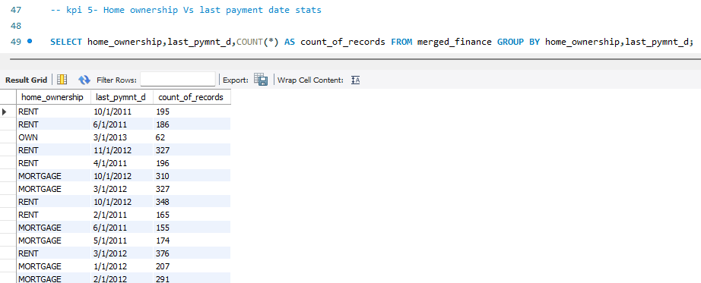
KPI - 5

Slide 14
CHALLENGES FACED
NULL VALUES : In Order (data column) and Review dataset (review score) has Null values ,they are replaced by correct numerical values or strings.
DUPLICATE VALUES : The duplicate in geolocation dataset are dropped through the “Remove duplicates” option in power query.
BUILD RELATIONSHIPS : For solving KPI’s we required data from two or more tables ,where there is no common column between Order and Product dataset, we taken “Oder items” table as support table to merge with other tables

Slide 15
THANK YOU

